Slide 1

Tata Steel Wires
Territory Attractiveness and Demand Forecasting
November 2016
The information contained in the document is proprietary to Tata Industries Limited- Tata Insights & Quants Division and is strictly confidential. In consideration of receipt of this document, the recipient agrees that the information is being shared only for the limited purpose. The recipient of this information further agrees to maintain such information in confidence and to not reproduce, disclose, duplicate, electronically transmit or use in whole or in part for any other purpose. Prior written consent shall be obtained from the Insights & Quants Division of Tata Industries in case the information is necessitated to be shared with anyone other than the Recipient to whom this information is addressed. The above restriction shall not limit the right to use the information contained in this deck, if it is obtained from another source without restriction.
© Copyright, Tata Insights & Quants Division, Tata Industries Limited

Slide 2
Contents
Data and Aggregation
Data Sources and Metrics Overview
Territory Attractiveness
Attractiveness Clusters and Scoring
Demand Forecasting
Techniques and Results
Confidential Property of Tata Industries Ltd – Tata Insights & Quants Division

Slide 3
Data and Aggregation
Confidential Property of Tata Industries Ltd – Tata Insights & Quants Division

Slide 4
Data Sources and Metrics
Aggregation of data across multiple sources provides a multi-dimensional view of a location
Monthly rainfall values by district
District level aggregation
Rainfall
GDP and Growth
Affluence and growth estimate
Area under cultivation
Area under irrigation
Population Sizing
GDP estimates and observed growth by district
Total and percentage population in rural and urban areas by agriculture related occupation, literacy levels etc.
Banking population proxy and exposure estimates and tractor and commercial vehicles purchase proxy
Total and percentage area under irrigation by crop
Total and percentage are under cultivation by crop
Confidential Property of Tata Industries Ltd – Tata Insights & Quants Division

Slide 5
Data Sources and Metrics – Sample View
Aggregation of data across multiple sources provides a multi-dimensional view of a location
Illustrative representation for three adjacent districts
Annual Rainfall
GDP value
Tractor Purchases Proxy
% Area Sown
In mm
In Rs. Cr.
% Area Cropped for grapes
% Area irrigated by tube wells
% Rural Population
Rural Cultivator population
Detailed list of variables
Confidential Property of Tata Industries Ltd – Tata Insights & Quants Division

Slide 6
Territory Attractiveness
Confidential Property of Tata Industries Ltd – Tata Insights & Quants Division

Slide 7


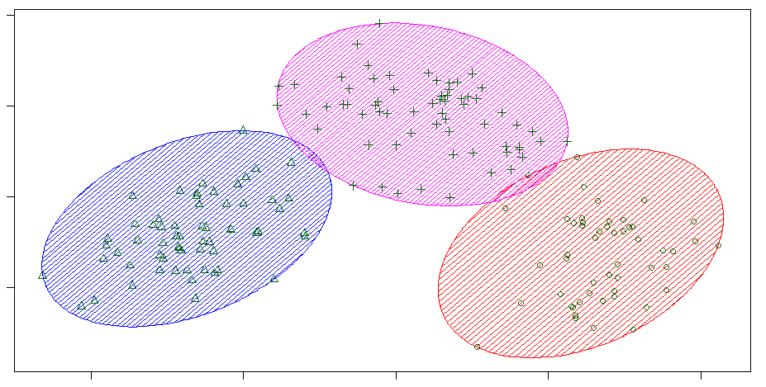
Segmentation Methodology
The methodology intends to capture the inherent diversity in the locational characteristics
Data sources
Metrics and proxies
Segmentation Algorithm
Aggregated at District level
Monthly and Annual rainfall
Banking population proxy
Two wheeler, Commercial vehicle buyer population proxy
Percentage of land are under cultivation, by crop
Percentage of land are under irrigation, by crop
Percentage of land are under irrigation, by channel
Rural population
Working, Cultivator and Agricultural labour population
Rainfall Statistics
GDP and Growth estimates
Land Usage statistics
Cultivation and Irrigation by crop
Population characteristics
Working population, Cultivator and agricultural labour population
Statistical technique to derive vital few metrics from the exhaustive list
Vital Metrics to drive separation between district characteristics and generate clusters
Composite Score
Segmentation Profiling
A composite performance score has been created at the district level
Sales data has been overlaid to understand the sales performance by the segments created
A score has been generated using the vital metrics to characterise each location’s relative attractiveness for sales generation
Segments profiled based on the vital metrics to
Provide characteristics to each segment
Prioritising segments
Illustrative
Segment 2
Segment 1
Segment 3
Confidential Property of Tata Industries Ltd – Tata Insights & Quants Division

Slide 8
Key Differentiating Factors
The components that are key differentiators in location characteristics were studied to arrive at final cluster inputs
Activity Hub
Location Characteristic Metrics
Activity Hub
Rainfall
Non Food Crop irrigated areas
Tractor buying Customers
Well Irrigated and Cropped
Rural, Cultivator population
Metric | Weightage
# Avg. Total Banking population proxy | 25%
# Avg. prominent bank branches | 25%
# Two Wheeler buying customers proxy | 26%
# Commercial Vehicle Customers proxy | 25%
Tractor buying Customers
Metric | Weightage
# Tractor Buying Customers proxy | 100%
Well Irrigated and Cropped
Metric | Weightage
% Of Land area irrigated | 20%
% of Irrigated area, irrigated by Tube Wells | 20%
% of Irrigated area, irrigated by Wells | 21%
% of Cropped Area | 19%
% Of Land area sown more than once | 19%
High Non Food Crop Irrigated areas
Metric | Weightage
% Non Food Crop Irrigated area | 100%
Rural, Cultivator population
Metric | Weightage
Total Rural Worker population | 23%
Cultivator Rural population | 20%
Total Rural Population | 20%
Main Agricultural Labourers Population Person Rural | 20%
Total Sown Area | 18%
Rainfall
Metric | Weightage
Rainfall - Oct 2014 | 32%
Rainfall - May 2014 | 36%
Total Rainfall - 2014 | 32%
Note: Additional factors such as areas irrigated by canal, tank and alternate sources were the other vital differentiating metrics
Confidential Property of Tata Industries Ltd – Tata Insights & Quants Division

Slide 9
Geo Location Clusters
The clusters built with the key differentiating factors as input
Key Differentiating Factors from all Data Sources
Cluster separation achieved in terms of
Activity hub
Well Irrigated and Cropped
Rural, Cultivator population
Rainfall
High Non Food Crop Irrigated areas
Tractor buying Customers
Irrigation from canals, tanks and alternate sources
Please refer attached excel for details
Moderate Activity, rainfall and irrigation
Mid level Activity, High Rural cultivator and agricultural labor volume
Low Activity
Well cropped and irrigated
Rural Cultivator Population
Low Rainfall, Limited Food grains cultivation
High Activity and Rainfall
Tractor purchases
Note: Land usage statistics are based on the latest available month for the different states; the timeframe thereby being different for different states
12% of the Sales data could not be mapped to any State and District
*Bubble size is indicative of net sown area
Confidential Property of Tata Industries Ltd – Tata Insights & Quants Division

Slide 10
Cluster Properties
These clusters are clearly distinguished by inherent properties apart from activity and rural cultivator population
Dimension estimates in graph are directional, kindly refer excel sheet for exact details
157
62
49
35
47
# Districts
Low Activity
Well cropped and irrigated
Low Rainfall, Limited Food grains cultivation
Moderate Activity, rainfall and irrigation
Mid Activity, High Rural cultivator and agricultural labor volume
High Activity and Rainfall
Confidential Property of Tata Industries Ltd – Tata Insights & Quants Division

Slide 11
Cluster Profiles
These clusters properties build a profile that helps build a business opinion on each segment
High Rural cultivator volume, with the total rural population being nearly 1.6X higher
Dimension estimates in graph are directional, kindly refer excel sheet for exact details
Highly Affluent with high rainfall and low total population
Low rainfall but about 45% of area is under non food crop cultivation
Low Affluent and low cultivator population but about 44% of the land area is irrigated
Characterised by ‘Mid value’ rainfall, population and irrigation
157
62
49
35
47
# Districts
Low Activity
Well cropped and irrigated
Low Rainfall, Limited Food grains cultivation
Moderate Activity, rainfall and irrigation
Mid Activity, High Rural cultivator and agricultural labor volume
High Activity and Rainfall
Confidential Property of Tata Industries Ltd – Tata Insights & Quants Division

Slide 12
Composite Score
Cluster properties were leveraged together with the total sales in each district to arrive at a district level composite score
0.02
3.1
0.03
2.9
0.05
6.1
0.07
7.3
0.11
15.1
Dimension estimates in graph are directional, kindly refer excel sheet for exact details
Average Sales per square kilometre (tonnage per sq. km)
Composite Score
The Composite score rank orders the sales at a segment level
157
62
49
35
47
# Districts
Low Activity
Well cropped and irrigated
Low Rainfall, Limited Food grains cultivation
Moderate Activity, rainfall and irrigation
Mid Activity, High Rural cultivator and agricultural labor volume
High Activity and Rainfall
Note: 12% of the Sales data could not be mapped to any State and District
Score developed and applied only on those districts where sales was non zero
Confidential Property of Tata Industries Ltd – Tata Insights & Quants Division

Slide 13
Composite Score – Sales Capture
The composite score rank orders the districts with respect to sales
% of total sales captured
The top 20% of the total districts selected as per the score capture more than 50% of the total sales
% of total districts scored
Note: 12% of the Sales data could not be mapped to any State and District
Score developed and applied only on those districts where sales was non zero
Confidential Property of Tata Industries Ltd – Tata Insights & Quants Division

Slide 14
Next Steps
Incorporate additional data elements for granularity in recommendation
  GDP values and growth (for districts and states available)
  Market level sales price by crop
Confidential Property of Tata Industries Ltd – Tata Insights & Quants Division

Slide 15
Demand Forecasting
Confidential Property of Tata Industries Ltd – Tata Insights & Quants Division

Slide 16
Forecasting Process
Metrics and proxies
Key Components
Segmentation Algorithm
Monthly and Annual rainfall
Banking population proxy
Two wheeler, Commercial vehicle buyer population proxy
Percentage of land are under cultivation, by crop
Percentage of land are under irrigation, by crop
Percentage of land are under irrigation, by channel
Rural population
Working, Cultivator and Agricultural labour population
Illustrative
Segment 2
Statistical technique to derive vital few metrics from the exhaustive list
Segment 1
Segment 3
Forecasting Results
Forecasting Process
Segment level time series metric for forecast
Segment level forecast
With a specified future timeframe
Overall and For each segment
Time series forecasting methodology accounts for
Trend
Seasonality
illustrative
Alternate time varying metrics, apart from the metric to be forecasted, e.g.
Rainfall
GDP growth etc.
To be evaluated for incorporation subsequently
Confidential Property of Tata Industries Ltd – Tata Insights & Quants Division

Slide 17
Primary Sales Forecasting Results
Trend Component
Seasonal Component
Random Component
Each Component projected and combined to forecast
Decomposed
The predicted values move in the same direction as the actual values
Data Used For Forecasting : TATA Wiron’s Primary sales data from Jan2014 to April2016 are used
Forecasted Values : TATA Wiron’s Primary Sales is forecasted for the months May, June and July of the year 2016
Confidential Property of Tata Industries Ltd – Tata Insights & Quants Division

Slide 18
Clustered Segments Level Secondary Sales Forecasting Results
Cluster - “Activity”
Cluster - “Rural Cultivator”
Data Used For Forecasting : TATA Wiron’s Secondary sales data for “Activity” cluster from April2014 to December2015 are used
Forecasted Values : TATA Wiron’s Secondary Sales for the “Activity” cluster is forecasted for the months January, February and March of the year 2016
Forecasting Results:
Data Used For Forecasting : TATA Wiron’s Secondary sales data for “Rural Cultivator” cluster from April2014 to December2015 are used
Forecasted Values : TATA Wiron’s Secondary Sales for the “Rural Cultivator” cluster is forecasted for the months January, February and March of 2016
Forecasting Results:
The predicted values move in the same direction as the actual values
The predicted values move in the same direction as the actual values
 | Actuals | Predicted | MAPE
Jan-16 | 759 | 1020 | 34.4%
Feb-16 | 896 | 1033 | 15.3%
Mar-16 | 982 | 1105 | 12.5%
 |  |  | 20.8%
 | Actuals | Predicted | MAPE
Jan-16 | 1248 | 831 | 33.4%
Feb-16 | 1339 | 1161 | 13.3%
Mar-16 | 1550 | 1154 | 25.5%
 |  |  | 24.1%
Confidential Property of Tata Industries Ltd – Tata Insights & Quants Division

Slide 19
Next Steps
  Refine and fine-tune forecasting results
  Evaluate incorporating other independent data sources for forecasting
Confidential Property of Tata Industries Ltd – Tata Insights & Quants Division

Slide 20
Thank You

Slide 21
Cluster Properties
These clusters are clearly distinguished by inherent properties apart from activity and cultivator population
Dimension estimates in graph are directional, kindly refer excel sheet for exact details
157
62
49
35
47
# Districts
Low Activity
Well cropped and irrigated
Low Rainfall, Limited Food grains cultivation
Moderate Activity, rainfall and irrigation
Mid Activity, High Rural cultivator and agricultural labor volume
High Activity and Rainfall
Confidential Property of Tata Industries Ltd – Tata Insights & Quants Division

Slide 22
Composite Score
Cluster properties were leveraged together with the total sales in each district to arrive at a district level composite score
0.03
3.1
0.03
2.9
0.06
6.1
0.07
7.3
0.18
15.1
Dimension estimates in graph are directional, kindly refer excel sheet for exact details
Average Sales per square kilometre (tonnage per sq. km)
Composite Score
The Composite score rank orders the sales at a segment level
157
62
49
35
47
# Districts
Low Activity
Well cropped and irrigated
Low Rainfall, Limited Food grains cultivation
Moderate Activity, rainfall and irrigation
Mid Activity, High Rural cultivator and agricultural labor volume
High Activity and Rainfall
Note: 12% of the Sales data could not be mapped to any State and District
Score developed and applied only on those districts where sales was non zero
Sales per sq. KM has also been calculated only for districts where sales is non zero
Confidential Property of Tata Industries Ltd – Tata Insights & Quants Division

Slide 23
Composite Score
Cluster properties were leveraged together with the total sales in each district to arrive at a district level composite score
124
136
240
246
411
394
870
931
735
619
Dimension estimates in graph are directional, kindly refer excel sheet for exact details
Average Sales per district (in tonnes)
Composite Score per district
The Composite score rank orders the sales at a segment level
157
62
49
35
47
# Districts
Low Activity
Well cropped and irrigated
Low Rainfall, Limited Food grains cultivation
Moderate Activity, rainfall and irrigation
Mid Activity, High Rural cultivator and agricultural labor volume
High Activity and Rainfall
Note: 12% of the Sales data could not be mapped to any State and District
Score developed and applied only on those districts where sales was non zero
Sales per sq. KM has also been calculated only for districts where sales is non zero
Confidential Property of Tata Industries Ltd – Tata Insights & Quants Division

Slide 24
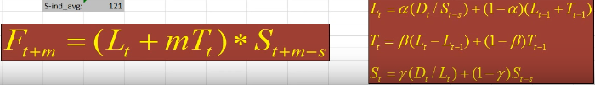
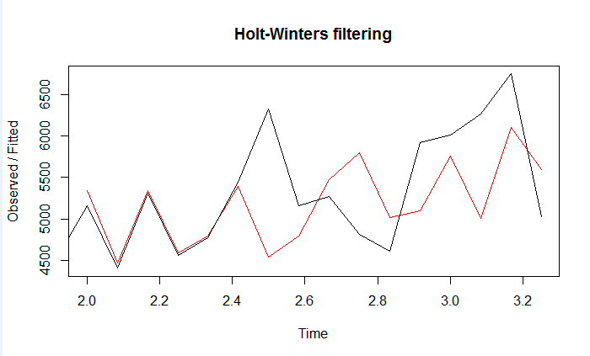
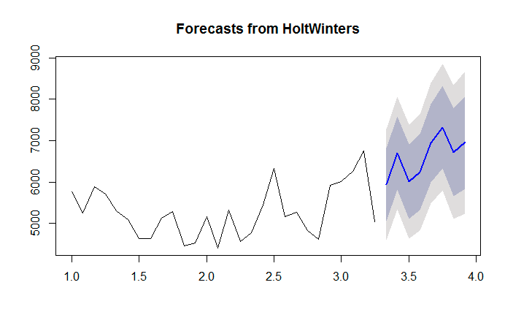
Holt-Winters Forecasting Technique
  Holt (1957) and Winters (1960) extended Holt’s method to capture seasonality. The Holt-Winters seasonal method comprises the forecast equation and three smoothing equations — one for the level L_{t}, one for trend T_{t}, and one for the seasonal component denoted by S_{t}, with smoothing parameters α, β and γ. We use s to denote the period of the seasonality, i.e., the number of seasons in a year. For example, for quarterly data s=4, and for monthly data s=12
Confidential Property of Tata Industries Ltd – Tata Insights & Quants Division

